Slide 1
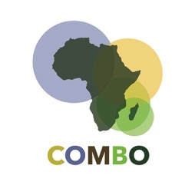
Module 12 – The COMBO Project
Training Modules for Applying the Mitigation Hierarchy:
Planning Policy and Projects for No Net Loss or a Net Gain of Biodiversity
Module 12
The COMBO Project

Slide 2
Module on COMBO – Abstract
This module describes the COMBO project, which has produced this training course, among other work over the period 2016-2019.
It introduces the country teams in Guinea, Madagascar, Mozambique and Uganda, and the international team drawn from WCS, Biotope and Forest Trends to support them.
The module introduces COMBO’s goal and objectives: to reconcile economic development and conservation of biodiversity and ecosystem services by working for no net loss of biodiversity, improving mitigation of industry impacts.
It explains each of COMBO’s components of work and progress to date.

Slide 3
Module on COMBO – Contents
Contents | Slides
The COMBO Project team | 4
COMBO Goal and Objective | 5-6
The main components of COMBO’s work | 7-13
Summary | 14

Slide 4
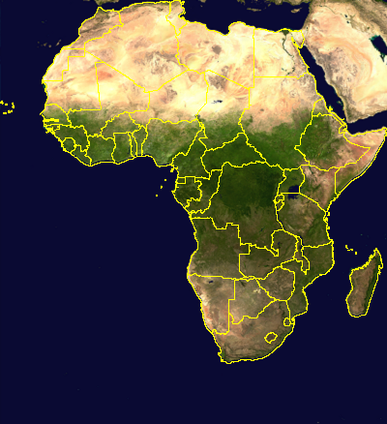
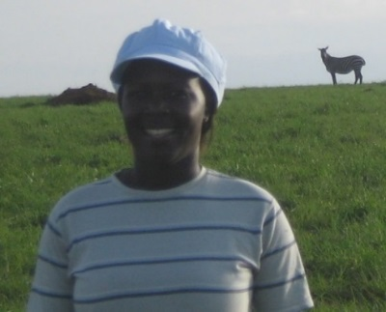
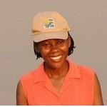
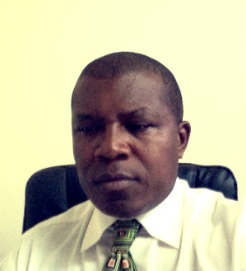
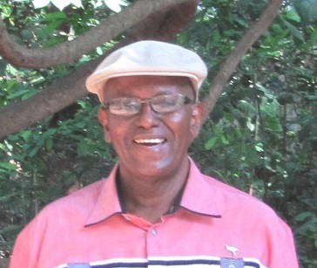
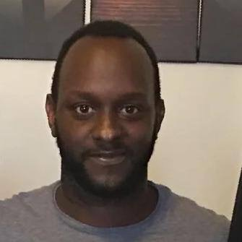
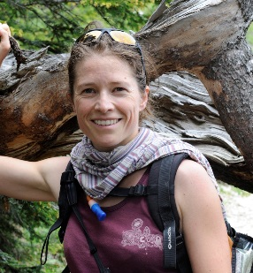
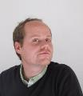
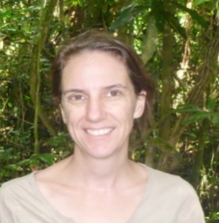
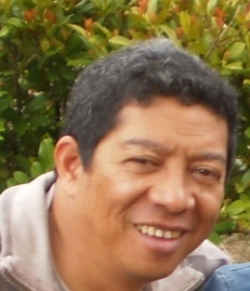
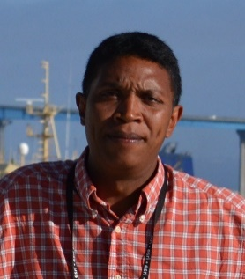
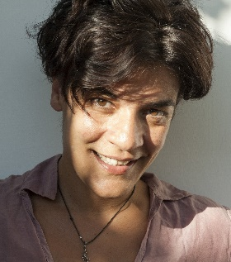
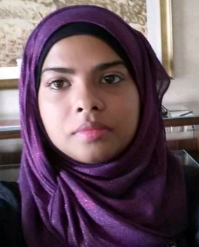
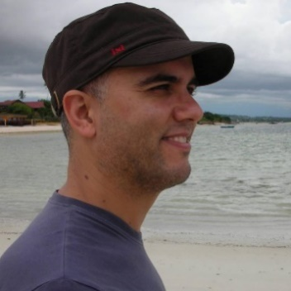
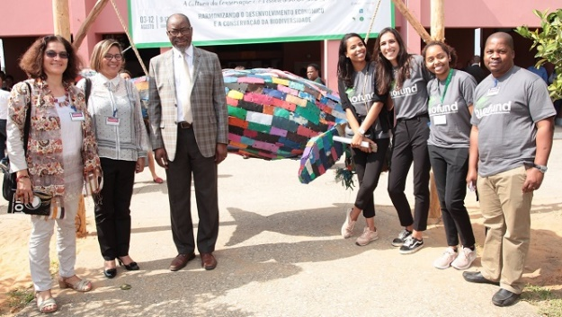
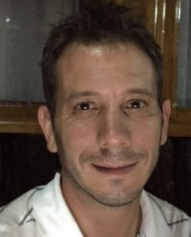
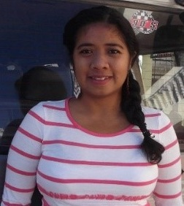
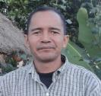
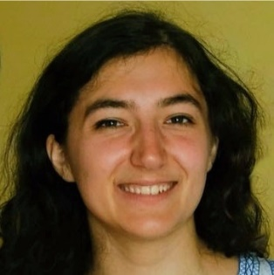
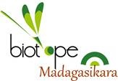
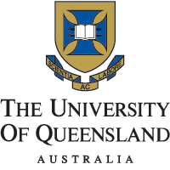
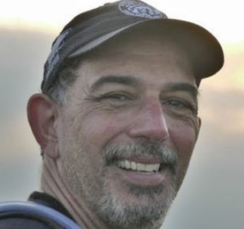
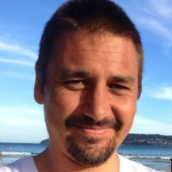
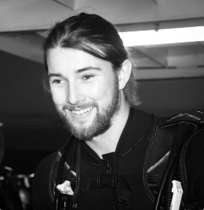
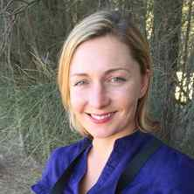
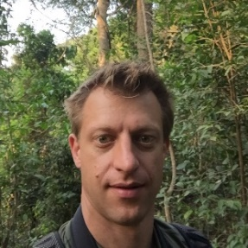
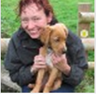
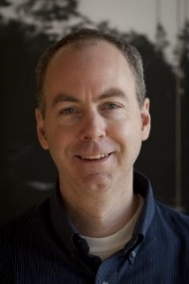
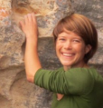
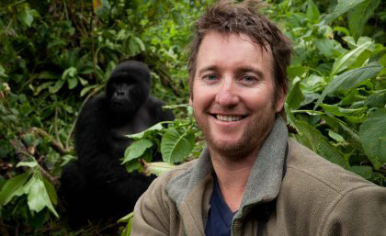
The COMBO Project team: 2016-2019
COMBO Uganda
COMBO Guinea
Mamadou Saliou
Diallo
Muhammad Yaya Diallo
Catherine
André-Munch
Fabien Quétier
Beatrice Kyasiimire
Simon Nampindo
Grace Nangendo
Alex Muhweezi
COMBO Madagascar
COMBO Mozambique
Alison Clausen
Dimby
Razafimpahanana
Rija Rajaonson
Daniela
Antonacci
Naseeba Sidat
Hugo Costa
Jim Bampton
Biofund
Guillaume
Crepin
Danielle Razaiarinony
José-Myriel
Ralison
Alexia Aussel
COMBO international team
Hugo
Rainey
Ray
Victurine
Hedley
Grantham
Kendall
Jones
Fabien
Quétier
Mathieu
Souquet
Kerry
ten Kate
Patrick
Maguire
Amrei
von Hase
Martine
Maron
James
Watson
Notes:
The COMBO project’s geographic scope and capacity of personnel

Slide 5
COMBO Goal and Objective
COnservation, Impact Mitigation, and Biodiversity Offsets in Africa

Slide 6
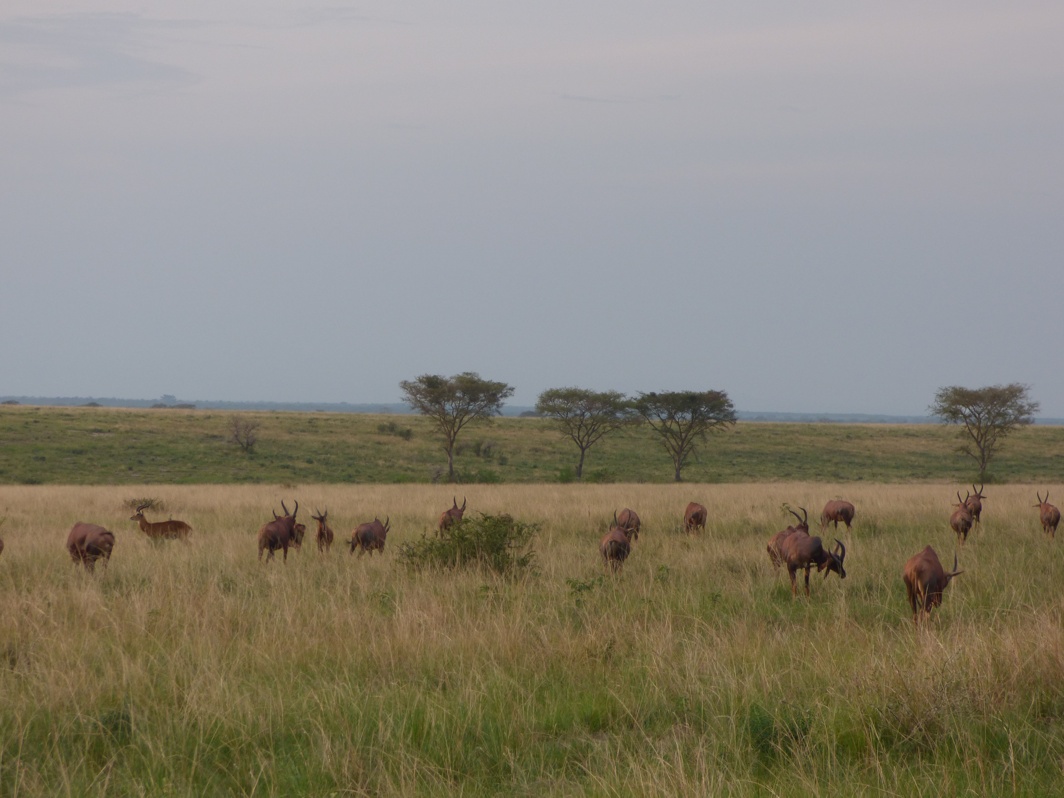
COMBO Goal and Objective
Goal: Reconcile economic development and conservation of biodiversity and ecosystem services in Africa by supporting government policiesthat target no net loss of biodiversity and improve mitigation of industry impacts.
Specific Objective: Contribute by 2019 to the definition and implementation of the mitigation hierarchy, including biodiversity offsets mechanisms, in Guinea, Madagascar, Mozambique and Uganda in which private and public investments endorse the target of NNL of biodiversity while generating additional funds for conservation.

Slide 7
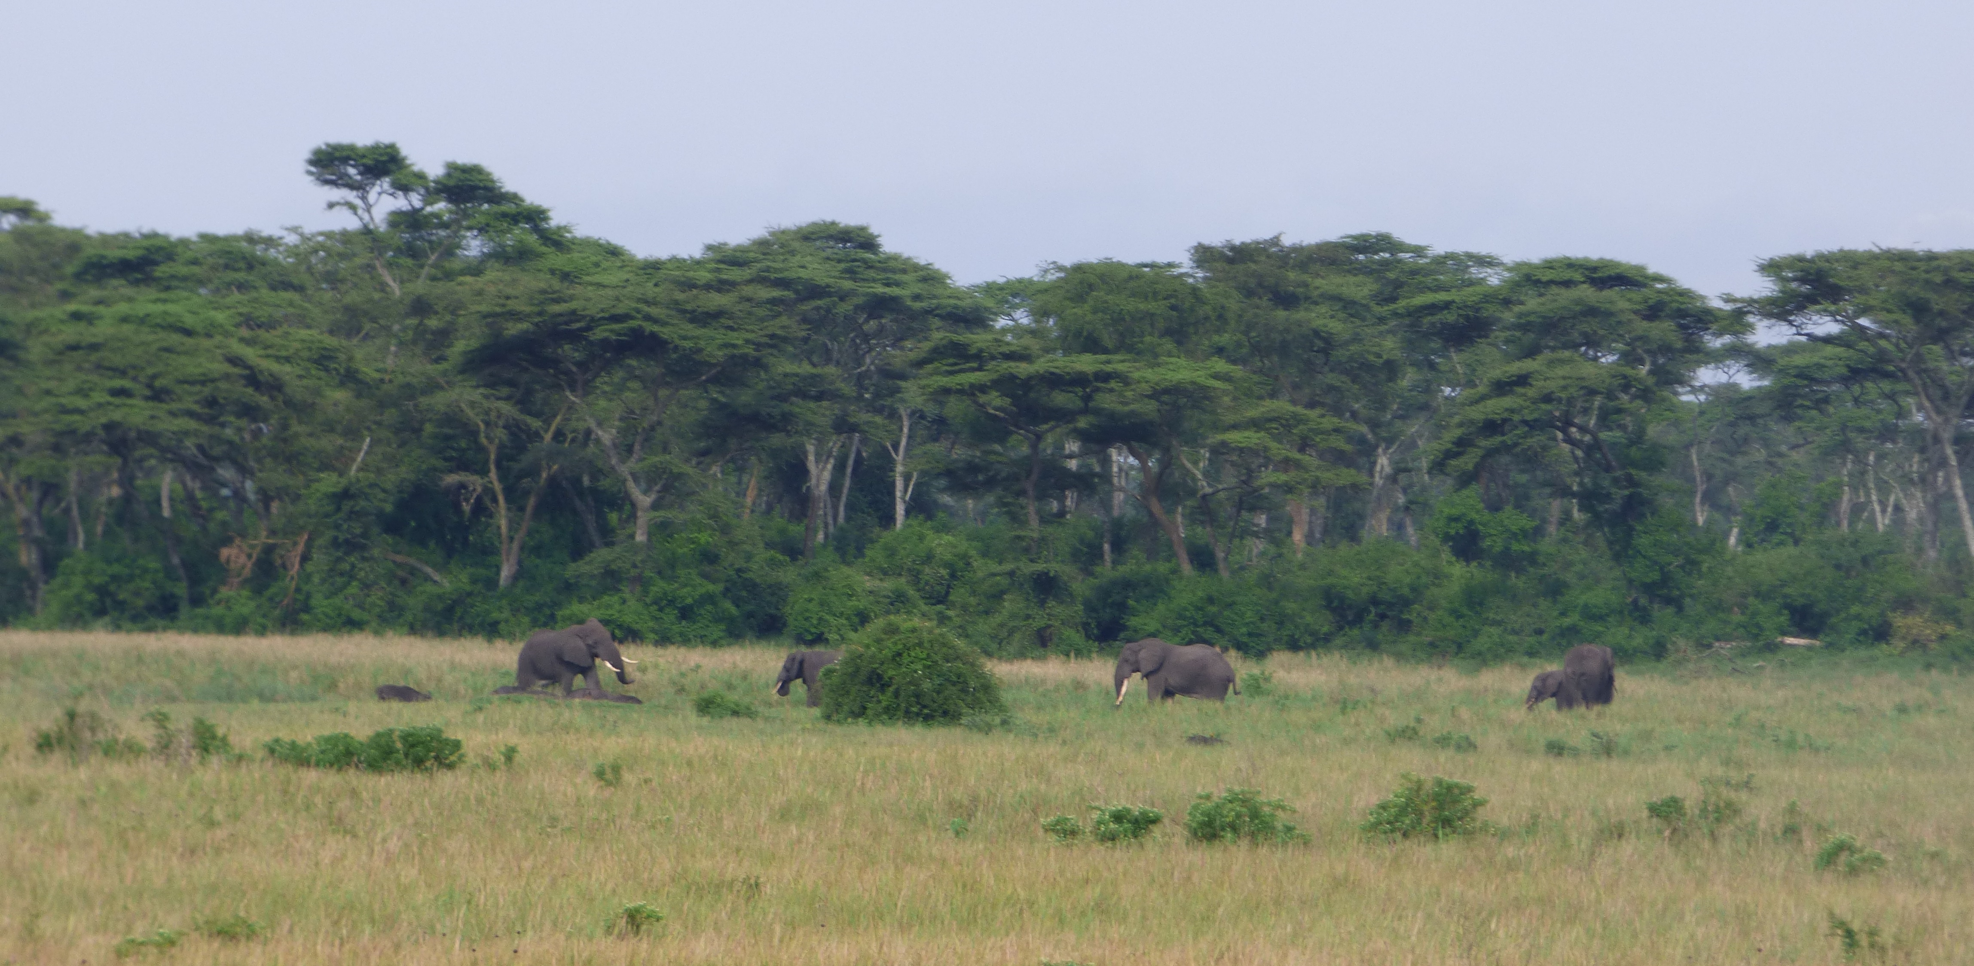
COMBO Project Components
1. Legal & Policy: Improving policy to reduce development project impacts on biodiversity
2. Planning & Measurement: Developing tools to measure potential impacts on biodiversity, identifying measures to reduce impacts and developing baseline and monitoring methodology
3. Implementation mechanisms: Developing institutional, legal and financial mechanisms for offset implementation, particularly those linked with conservation trust funds to secure the permanence of conservation outcomes
4. Private sector case studies: Supporting the uptake of best practice in the public and private sectors, monitoring these initiatives and developing lessons learnt.
5. Capacity-building: Building national and regional capacity by sharing lessons learnt

Slide 8
Component 1 – Policy
Objective 1. Assist governments in the identification, analysis and introduction of appropriate policy to encourage investment in development projects that result in no net loss or a net gain of biodiversity.
Progress
Policy and capacity gap analyses completed
Policy options reviewed with governments and stakeholders
Support to existing policy updates (Mozambique Conservation Law, Review of MECIE in Madagascar, Uganda Environmental Bill, Uganda offsets guidance, Guinea law)
2019
August 2017
2017
2018
NNL/NG MH strategy and action plan
Stratégie NNL/NG-HA et plan d'action
Policy & capacity gap analyses
Analyses des lacunes juridique et de capacité
Synthesis of gap analysis
Synthèse de l’analyse des lacunes
Identification of policy options
Identification d’une série d’options légales
Selection (refining) policy options
Sélection (affinée) d’options légales
Implementation recommendations Recommandations sur la mise en œuvre

Slide 9
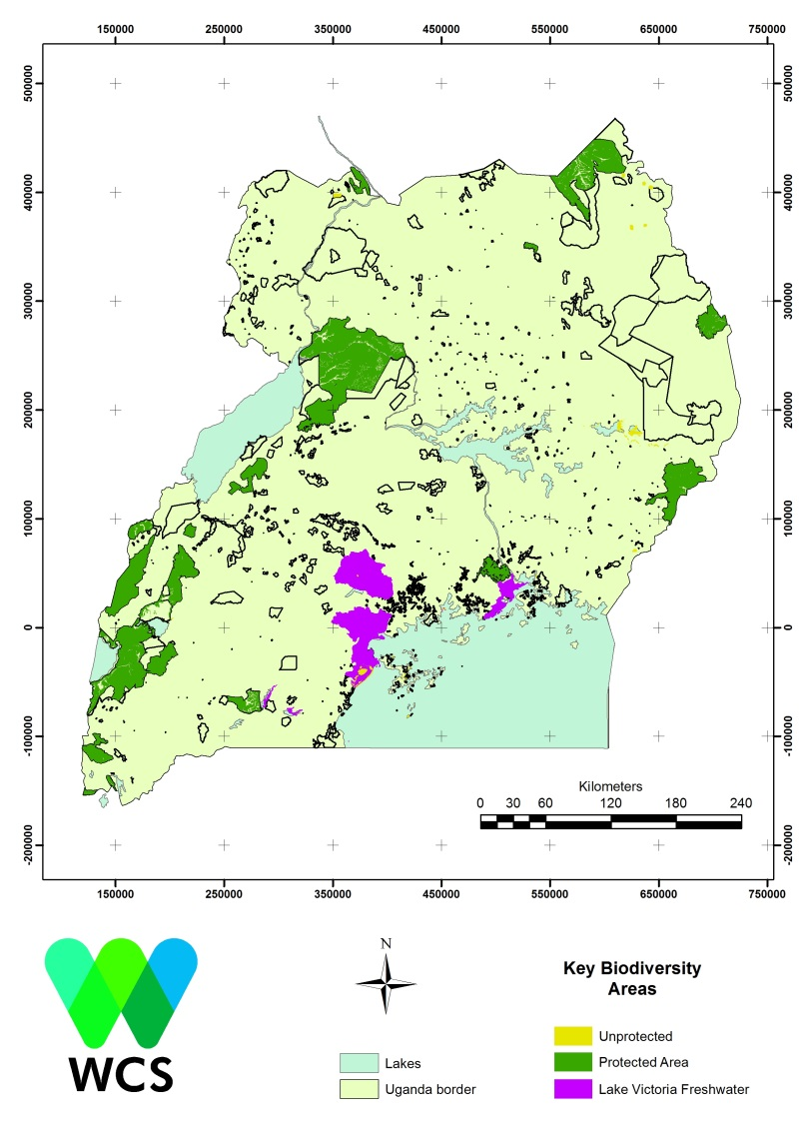
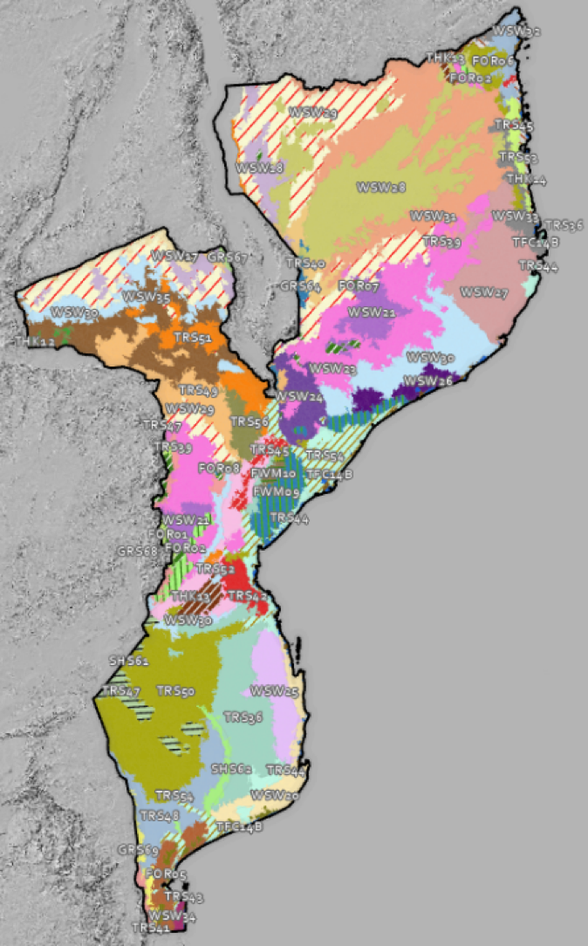
Component 2 – Planning and measurement tools
Objective 2. Create the enabling conditions for development projects to achieve no net loss of biodiversity by: supporting national planning processes; identifying relevant biodiversity metrics; and developing and implementing baseline and monitoring survey methodology.
Progress
Data gap analyses completed in all 4 countries: 3,000 databases in Mozambique, 300 in Guinea, 112 in Madagascar
Assuring long term data access is a question
Spatial planning and habitat quality analysis almost complete in Uganda; underway in other countries
National Key Biodiversity Area identification in Uganda
Lötter et al. (In Prep)

Slide 10
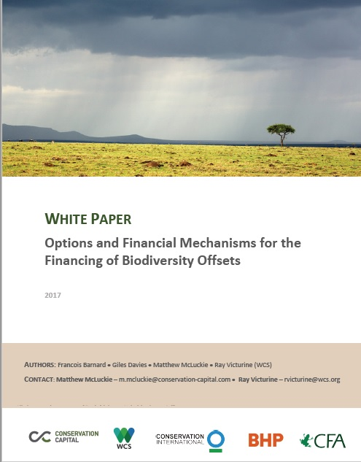
Component 3 – Implementation
Objective 3. Develop institutional, legal and financial mechanisms for implementation of offsets, particularly those linked with conservation trust funds, to secure the permanence of conservation outcomes from the mitigation hierarchy.
Progress
Offsets financing white paper
Implementation options review: who, where, what, why, when, how
Coordination with Biofund and Government of Mozambique on developing procedures for offset design and management
Review with FAPBM and Tany Meva of feasibility of offset financing
Review of offset financing in Guinea with mining companies
Development of offsets guidance with Ugandan Government

Slide 11
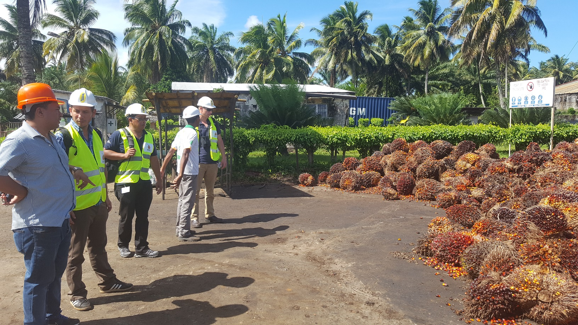
Component 4 – Uptake in public and private sectors
Objective 4. Support the uptake of best practice in the public and private sectors, monitoring these initiatives and developing lessons learnt
Progress
7 MOUs for industry case studies signed in three countries, several more in pipeline
Methodology updated for working with smaller, non-extractive companies
Case study analysis underway for three projects in Madgascar, two in Mozambique
Working with regulators to evaluate ESIA reports to build on industry case studies

Slide 12
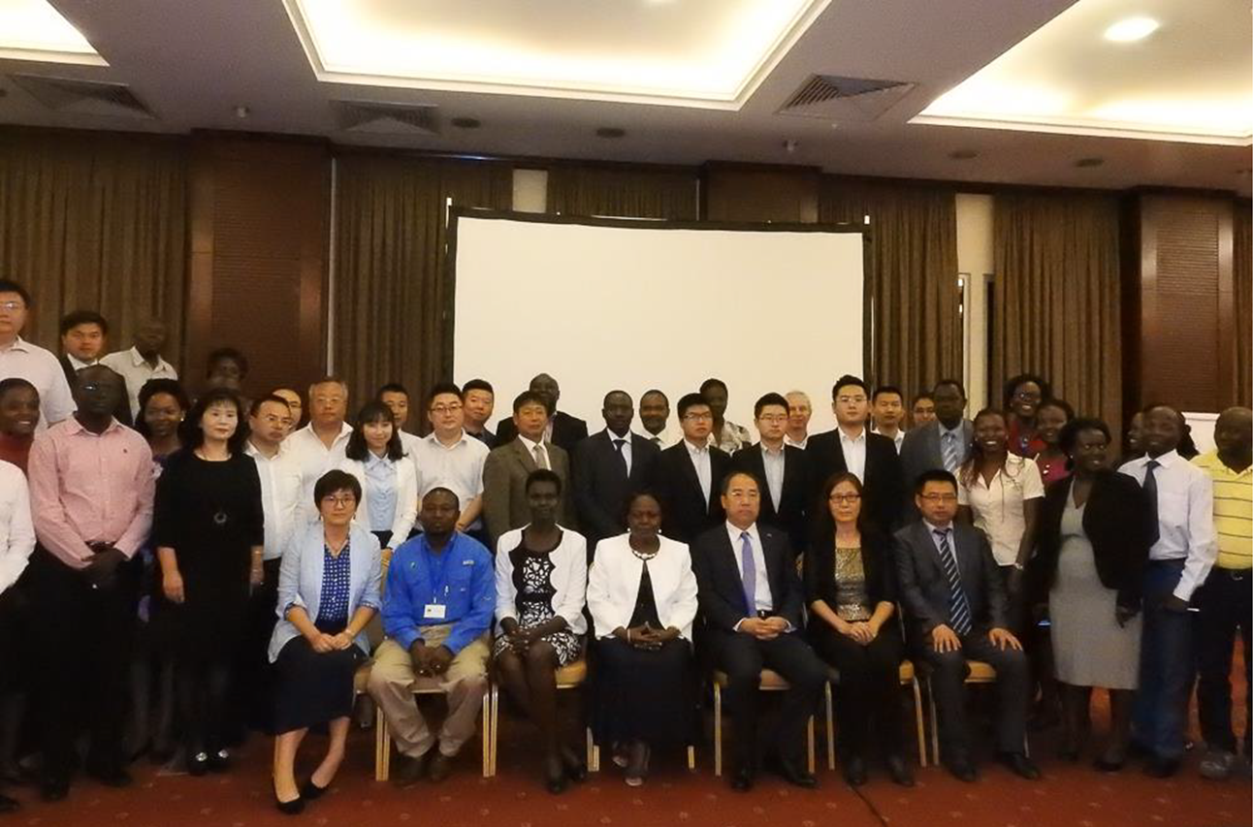
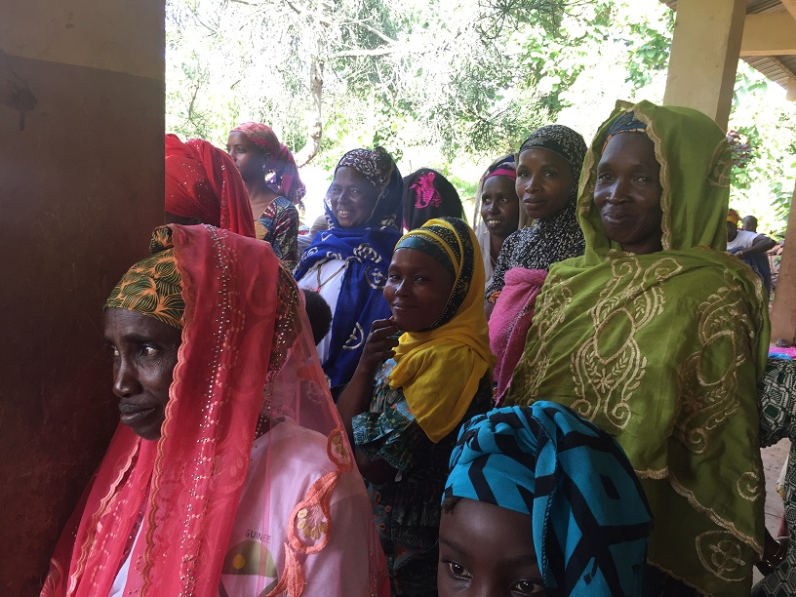
Component 5 – Capacity building
Objective 5. Build national and regional capacity by sharing lessons learnt drawn from African and global experiences of no net loss activities with a wide range of involved stakeholders
Progress
First major training sessions held in 2016, further major training sessions held in other countries
Industry, government and civil society trained
Ongoing training and support with individual institutions to engage many people at low cost
This training deck!

Slide 13
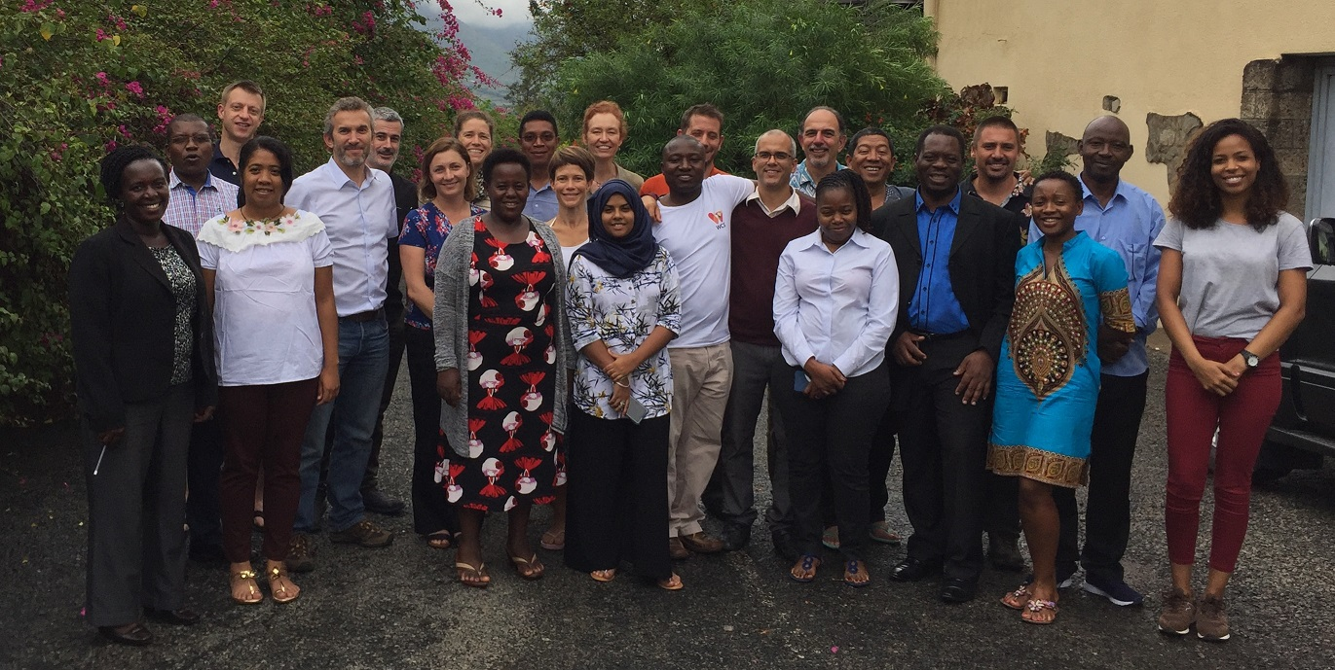
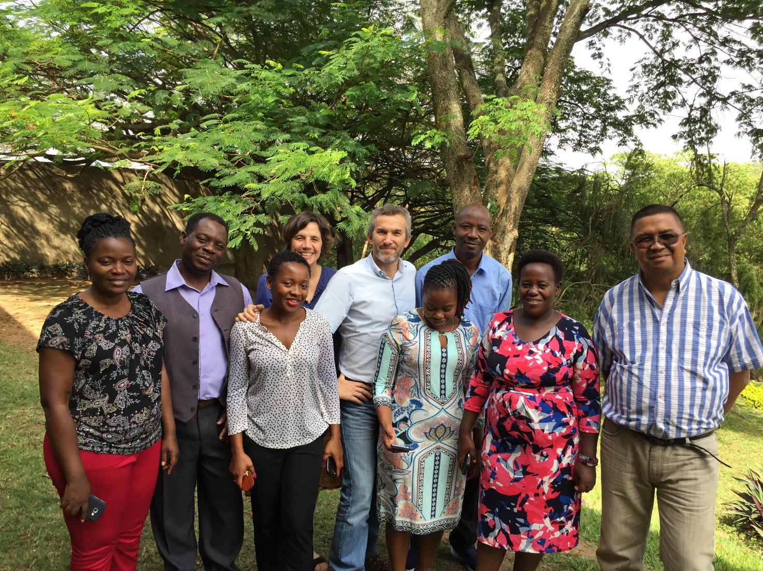
Component 6 – Project management
Progress
Mid-term evaluation held in March 2018
Government MOUs signed
Government engagement through Steering Committees essential
COMBO outputs require high investment in communication of outputs
Final evaluation in October-November 2019.

Slide 14
Module on COMBO – Summary
COMBO stands for COnservation, impact Mitigation and Biodiversity Offsets in Africa, and is a project run by WCS, Biotope and Forest Trends with the support of AFD, FFEM and the Mava Foundation. The project aims to improve biodiversity outcomes from better development and industry practice in four African countries.
COMBO’s Goal is to reconcile economic development and conservation of biodiversity and ecosystem services in Africa by supporting government policies that target no net loss of biodiversity and improve mitigation of industry impacts.
The Specific Objective is to contribute by 2019 to the definition and implementation of the mitigation hierarchy, including biodiversity offsets mechanisms, in Guinea, Madagascar, Mozambique and Uganda in which private and public investments endorse the target of No Net Loss of biodiversity while generating additional funds for conservation.
The first component of work is to assist governments in the identification, analysis and introduction of appropriate policy to encourage investment in development projects that result in no net loss or a net gain of biodiversity.
The second is to create the enabling conditions for development projects to achieve no net loss of biodiversity by: supporting national planning processes; identifying relevant biodiversity metrics; and developing and implementing baseline and monitoring survey methodology.
Third, is to develop institutional, legal and financial mechanisms for implementation of offsets, particularly those linked with conservation trust funds, to secure the permanence of conservation outcomes from the mitigation hierarchy.
The fourth component supports the uptake of best practice in the public and private sectors, monitoring these initiatives and developing lessons learnt.
The final substantive component is to build national and regional capacity by sharing lessons learnt drawn from African and global experiences of no net loss activities with a wide range of involved stakeholders.
The results from the project are outlined, with detail provided in the separate module on ‘Lessons Learned’.

